Slide 1


Empower mobile web developers with JavaScript & WebAPI
Frédéric Harper
Sr. Technical Evangelist @ Mozilla
@fharper | outofcomfortzone.net
Prague JS
Prague, Czech Republic
2014-03-27
Notes:
START CAMTASIA
START ZOOM IT – ALT Z for permanent zoom
This presentation is 60 minutes
Present myself
Don’t take note
Slides on oocz.net

Slide 2
Omlouváme se, nemluvím česky
Thanks Google translate…
Notes:
Often try to learn one sentence
I always fail
Thanks Google Translate

Slide 3
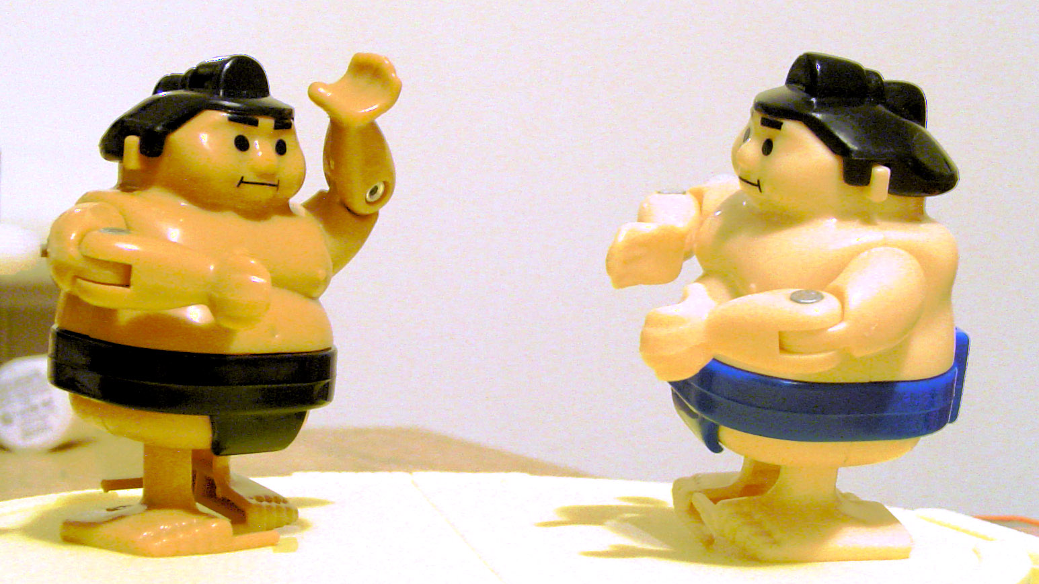
Creative Commons: http://j.mp/1ljZuJC
Notes:
Mostly since HTML5
Fight or eternal question about native app vs web app
For me, it feels like a sumo fight
Who is the bigger!

Slide 4
38 billion devices connected in 2020
ABI Research - 2013-05-09 - http://j.mp/38billion
Notes:
More than 38 billions devices connected in 2020

Slide 5
TODO: add picture of full web devices
Notes:
That’s not only iPhone or Android devices
TV, game console, refrigerator…

Slide 6

You should start with the web…
Notes:
So as app developers
For your customers
The first reflex would be to start with the web
So you can reach as many people as possible
HTML5 is a revolution

Slide 7
Notes:
Sometimes it feels like this
Even more when we think about mobile app
Not easy to have access to hardware like with native development

Slide 8

Notes:
Let me show you how HTML5 can fix the mobile web
Can empower javascript developers

Slide 9
What you deserve
Notes:
Let’s start with what you deserve

Slide 10
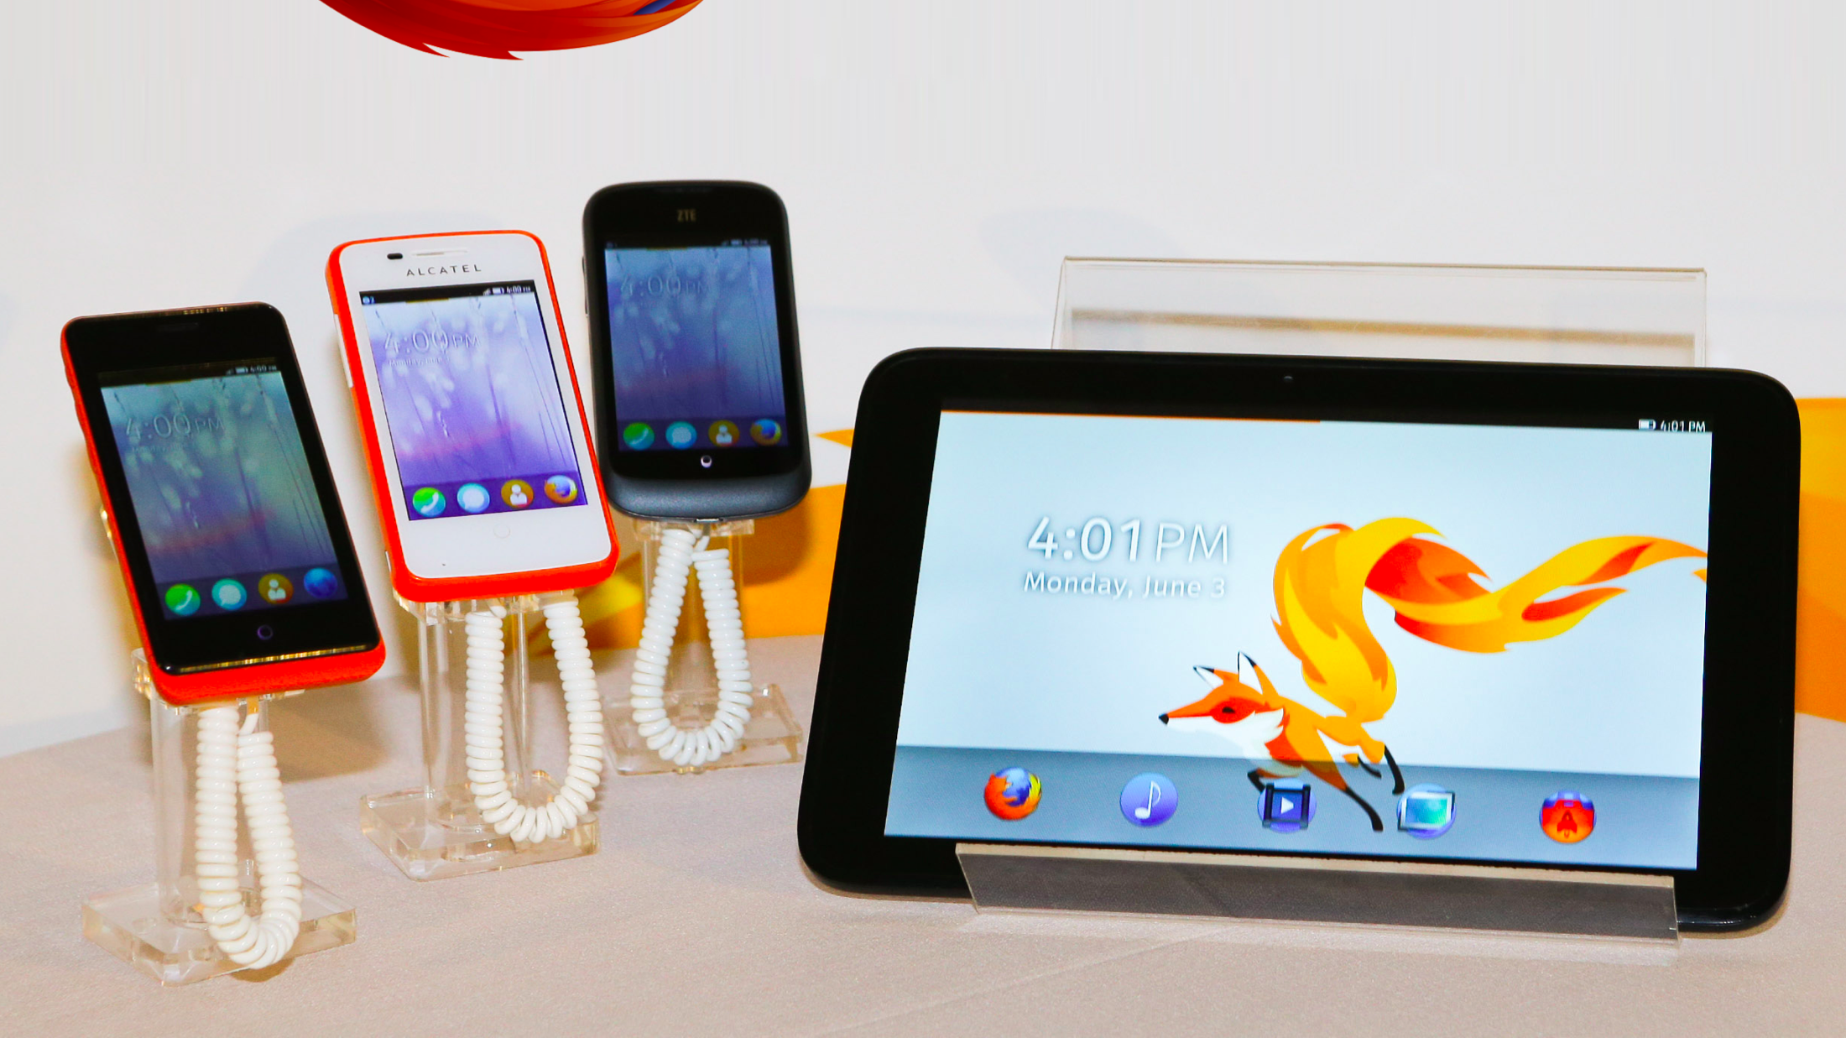
Notes:
Firefox OS, Mozilla launched one year ago

Slide 11
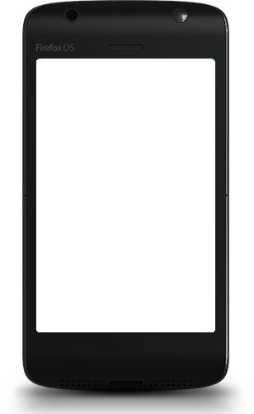
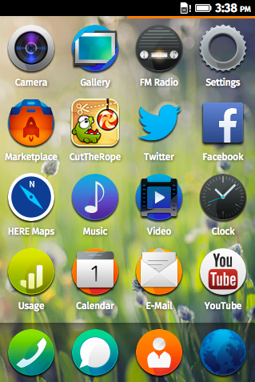
Built with the Web
Using HTML5, CSS3 and JavaScript
with a number of APIs
to build apps.
Notes:
It’s built with the web, for the web, and with the web
You use the technology you know, HTML5, CSS3, and JavaScript
No need to learn a new language
We added a number of APIs to make HTML5 even more awesome
As you can see, it’s a UI familiar for smartphone users

Slide 12
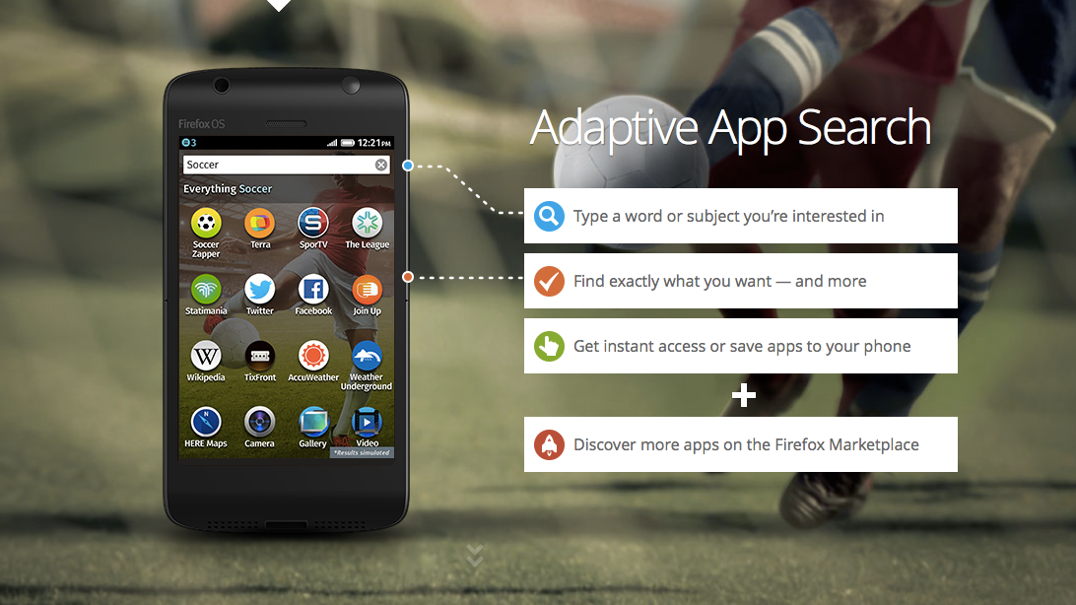
Notes:
You even have what we call adaptive search
No need to install application to use them
Your phone adapt to your need
The web is your marketplace

Slide 13

It’s open source
Notes:
It’s Open Source
You everybody can contribute
Fix bug, add features or suggest them
The repository is on GitHub

Slide 14
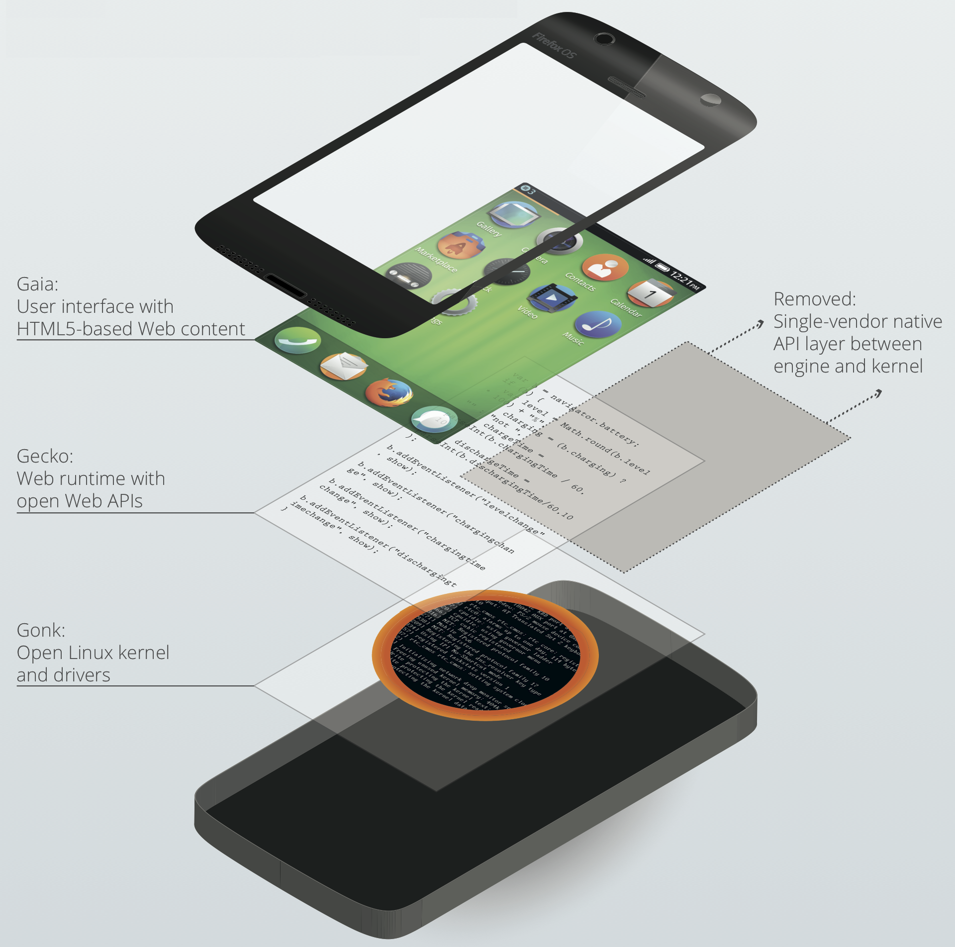
Architecture
Notes:
The architecture is simple to ensure the maximum speed for the devices
The based use the Gonk Linux distro
On top of that we add Gecko, our engine behind Firefox
Last, but not least, Gaia, the os, all made also with HTML

Slide 15
Benefits of HTML5
In-built distribution – the Web
Simple technologies used by a lot of developers
Evolution of existing practices
Open, independent, and standardized
Notes:
I don’t I have to list you the benefits of HTML

Slide 16















Some facts
7 mobile operator & 4 hardware partners
ZTE Open, Alcatel One Touch Fire, Geeksphone Keon, Geeksphone Peak, LG FireWeb…
More to come: Huawei Y300, ZTE Open C, Alcatel One Touche Fire C & E & S…
Aimed at emerging markets/low end market
Notes:
In one year, we launched on 15 countries
Worked with 7 operators & 4 hardware partners
We have 5 phones
Many will be added soon
You need to keep in mind that those are for emergent market

Slide 17
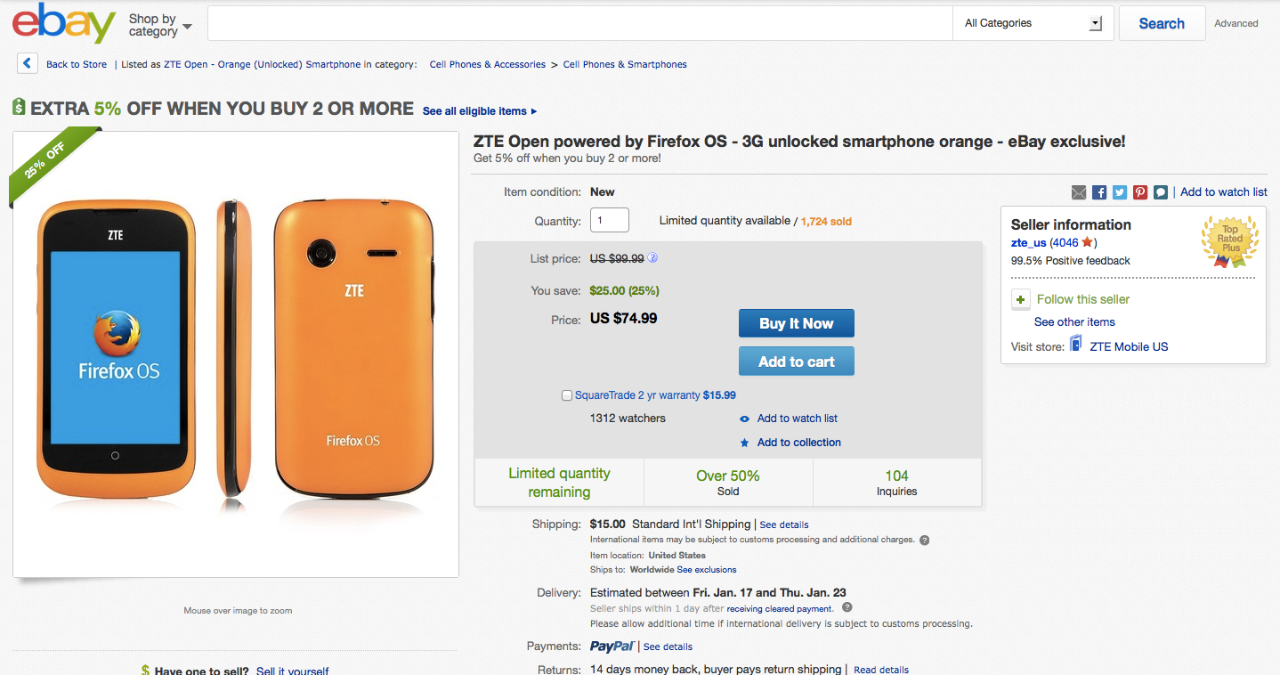
Notes:
Since they are for emerging market
They are level entry smartphones
So you can get them for about 100$, like the ZTE Open on eBay
No contracts, full price

Slide 18
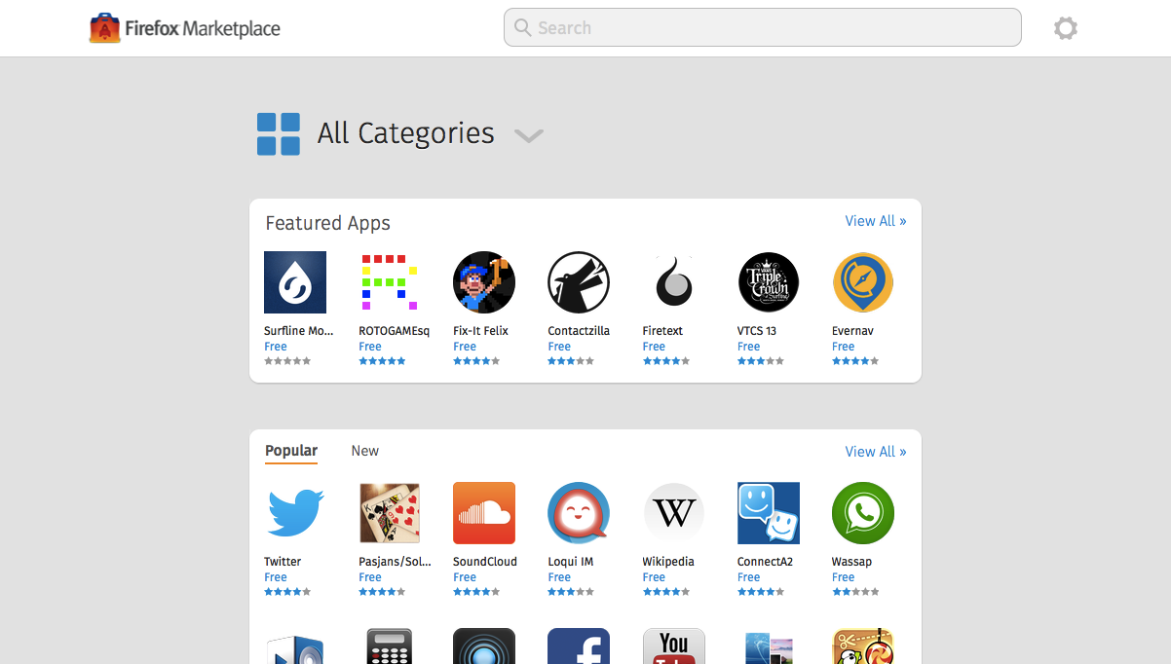
Notes:
It’s doesn’t mean it’s a smartphone with compromise
When we say smartphone, we say apps
We also have a marketplace
But since it’s an open ecosystem, we don’t force you to use it
We also don’t charge you to use it (except a small amount for paid app)
But we highly encourage you to do so, as it’s the place users will search first for app

Slide 19
A Firefox OS app?
Creating a hosted or packaged app
Using
Vanilla HTML5
Librairies…
Regular API
Privileged API
Certified API
Notes:
So what is a Firefox OS app
It’s a web app, either hosted or packaged
Hosted app are on your own server or places like github pages
Packaged app are published in the marketplace, we host them
You can either use what I call vanilla html, or use any libraries you want
You can also use WebAPI if you want to have a better integration with the device

Slide 20
HTML5 + manifest (JSON) = Firefox OS app
{
"version": “42",
"name": ”My amazing app",
"launch_path": "/index.html",
"description": ”My super amazing app do super amazing things",
"icons": {
"16": "/images/logo16.png”,},
"developer": {
"name": ”Frédéric Harper",
"url": "http://outofcomfortzone.net",
},
"default_locale": "en",
"permissions": {
"geolocation": {
"description": ”Get the long/lat of the user"
}
}
}
Notes:
So today, if you have a web application
You already have a Firefox OS one
Of course, you may have to adjust some part of it
But if it’s running well in Firefox the desktop the browser
And you use something like responsive web design
The only thing to do is to add a manifest file
It’s basically a JSON file to tell Firefox OS it’s an app
You add all the details about your applications
But also things like permissions
It’s not because it’s web, that it’s not secure

Slide 21
DEMO
Emberjs todomvc
Notes:
To show you how it’s easy
I’ll take the TodoMVC code using ember.js
I’ll create a Firefox OS app with it
Open App Manager
Explain App Manager

Slide 22
Web APIs
Notes:
So now you have a Firefox OS application
But you want to have a better integration with the platform
So we created what we called WebAPI
They are API, using HTML, and JavaScript to empower developers
We built them for Firefox OS
But we work with the W3C, and standard buddy to make them part of the standard
As our goal isn’t to have API only working on Firefox OS, we want the web to work
And if tomorrow the standard change, we’ll make the change to reflect this on the OS

Slide 23

Web APIs – Regular
Alarm API
Ambient light sensor
Archive API
Battery Status API
Geolocation API
IndexedDB
Network Information API
Notifications API
Open WebApps
Proximity sensor
Push API
Screen Orientation
Vibration API
Web Activities
WebFM API
WebPayment
packaged
hosted
Notes:
I quickly shown you three level of API
The first level, is the regular API
You can use them on hosted or packaged app
No need for us to certify your application
Here are some of those APIs you can use

Slide 24
Ambient Light Sensor
Notes:
Let’s start with the Ambien light API
This API will give you the ability to get values about the ambient light
Could be useful if you are building an reading app, and wants to change the color if it’s darker or not

Slide 25
Ambient Light Sensor
window.addEventListener("devicelight", function (event) {
// The level of the ambient light in lux
// The lux values for "dim" typically begin below 50,
// and the values for "bright" begin above 10000
console.log(event.value);
});
Notes:
It’s quite simple, you need to add a listener on devicelight
Your function will get call when the ambient light will change
You’ll get a value in lux

Slide 26
DEMO
Boilerplate – Ambient Light Sensor
Notes:
Open Droid@Screen
Connect a real device to the laptop
Open Firefox OS Boilerplate
Click the Ambient Light button
Show the value
Put your hand in front of the device
Show the new light value

Slide 27
Battery Status
Notes:
The next one is kind of obvious
It will give you information on the battery
Something you weren’t able to do with web technology
Useful to save the data of your user or stop some effect in your game when the battery is too low

Slide 28
Battery Status
var battery = navigator.battery;
if (battery) {
var batteryLevel = Math.round(battery.level * 100) + "%",
charging = (battery.charging)? “yes" : "no",
chargingTime = parseInt(battery.chargingTime / 60, 10,
dischargingTime = parseInt(battery.dischargingTime / 60, 10);
battery.addEventListener("levelchange", setStatus, false);
battery.addEventListener("chargingchange", setStatus, false);
battery.addEventListener("chargingtimechange", setStatus, false);
}
Notes:
You can get the battery level by getting the value of navigator.battery.level
You can also do this for charging time, and discharging time
Another way is to manage event listener on the levelchange, chargingchange, and chargingtimechange
It’s not just useful for a battery information app, but you can take advantage of it

Slide 29
DEMO
Boilerplate – Battery status
Notes:
Let’s use again Firefox OS Boilerplate App
Open Droid@Screen
Connect a real device to the laptop
Open Firefox OS Boilerplate
Click the battery button
Show the information

Slide 30
Web APIs – Privileged
Browser API
Contacts API
Device Storage API
systemXHR
TCP Socket API
packaged
Notes:
There is a second level of APIs
This time they are the privileged APIs
You can use those one only with packaged app
In that case, no choice to submit your application to the marketplace
So we’ll check if you aren’t doing something evil with your code

Slide 31
Browser
Notes:
The name of this API is pretty clear
I remember many native applications on other platform that were just windows on HTML application
Now since your application is HTML, the utility for this API would be to let the user navigate to an external website
It could be helpful if you have to made the user log in into a third party services, and approve a key for your application, as an example

Slide 32
Browser
<div>
<span id='location-bar'></span>
<button onclick='go_button_clicked()'>Go</button>
</div>
<div id='load-status'></div>
<div id='security-status'></div>
<img id='favicon'>
<div id='title'></div>
<iframe mozbrowser src=‘yoursite.com' id='browser'></iframe>
Notes:
You can add a browser iframe in your application, by adding some code
Note that the important part is the mozbrowser attribute in the iframe element
If you also want to have a kind of full browser experience, you can add the other elements with those IDs

Slide 33
Browser
addEventListener('mozbrowserloadstart', function(e) {
//Do stuff
});
/*
Possible values:
"mozbrowserloadstart“ "mozbrowserloadend"
"mozbrowserlocationchange“ "mozbrowsertitlechange"
"mozbrowsericonchange“ "mozbrowsersecuritychange"
"mozbrowsercontextmenu“ "mozbrowsererror"
"mozbrowserkeyevent“ "mozbrowsershowmodalprompt"
"mozbrowseropenwindow“ "mozbrowserclose"
*/
Notes:
You can also add different listener for different action from the users, but also from the browser iframe
In one application I’m building, I use this to grab the URL that the website return after the user sign-in
In contain the key for me to access the API, and account of the users

Slide 34
Contacts
Notes:
Another nice privileged API give you access to the contact list

Slide 35
Contacts
var contact = new mozContact();
contact.init({name: "Tom"});
var request = navigator.mozContacts.save(contact);
request.onsuccess = function() {
console.log("Success");
};
request.onerror = function() {
console.log("Error")
};
Notes:
You can get add, modify, and delete a contact to the list
You can also find, and select all contacts
This code example show you how to add a contact to the address book of the user’s phone

Slide 36
Web APIs – Certified
Camera API
Idle API
Mobile Connection API
Network Stats API
Permissions API
Power Management API
Settings API
Time/Clock API
Voicemail
WebBluetooth
WebSMS
WebTelephony
WiFi Information API
OS/OEM
Notes:
Last, but not least, the Certified API
I won’t take too much time for those
As only OEM, or OS applications can use them
It’s good to know that they exists
As they may move to the privileged or regular API in the future

Slide 37
Web Activities
Notes:
So how can you do stuff you would do with certified API
We have something we called Web Activites

Slide 38
Web Activities
browse
configure
costcontrol
dial
open
pick
record
save-bookmark
share
view
update
new
mail
websms/sms
webcontacts/contact
Notes:
Each of those activites give you more power to either interact with the users, the OS, or the hardware

Slide 39
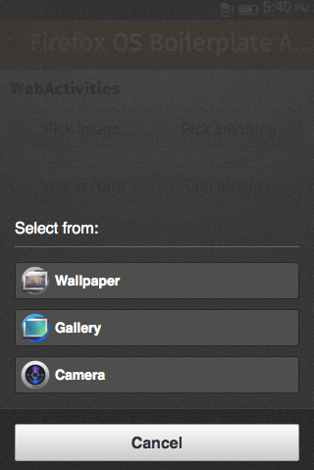
Pick
var activity = new MozActivity({
name: "pick",
//Provide the data required
//by the filter of the activity
data: {
type: "image/jpeg"
}
});
Notes:
As an example
The Pick Web Activities
It give me the opportunity to pick something, in that case an image
By using those lines of JavaScript
The app will prompt the screen you see on the right
The users will have the choice to either use a wallpaper
a picture he already had on his phone
Or use the camera to take a picture

Slide 40
Pick
activity.onsuccess = function () {
var img = document.createElement("img");
if (this.result.blob.type.indexOf("image") != -1) {
img.src = window.URL.createObjectURL(this.result.blob);
}
};
activity.onerror = function () {
//error
};
Notes:
In that case, depending on what the user did
An event will be triggered
You’ll be able to use the image in your app
Or handle the error in case of a problem, like if the user cancel the action

Slide 41
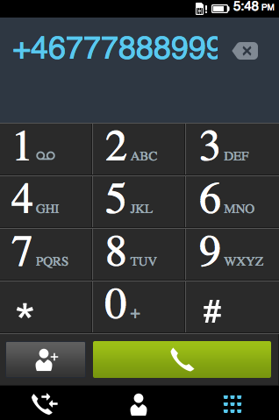
Dial
var call = new MozActivity({
name: "dial",
data: {
number: "+46777888999"
}
});
Notes:
Another one is the dial web activities
It doesn’t give you the right to call someone
But by adding those JavaScript lines
The dialer app will open with the number
The user will only have to press the green button to call

Slide 42
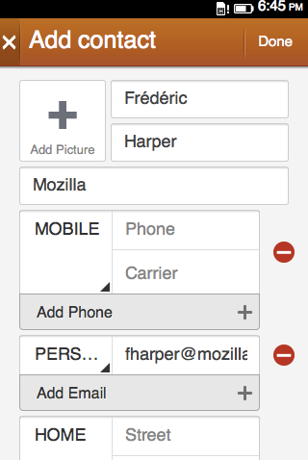
new webcontacts/contact
var newContact = new MozActivity({
name: "new",
data: {
type: "webcontacts/contact",
params: {
givenName: "Frédéric",
lastName: "Harper",
email: ”fharper@mozilla.com",
company: "Mozilla"
}
}
});
Notes:
You can also create contact, again, with JavaScript
Nothing complex here, and as with the dial one
The user will see a screen prefilled with the information
He’ll only have to confirm the information, and save the new contact

Slide 43
Web Activity Received Handler
"activities": {
"pick": {
"filters": {
"type": ["image/jpeg", "image/png"]
},
"disposition": "inline",
"returnValue": true,
"href": "/index.html#pick"
}
}
Notes:
It’s not just about managing activities from within your application
You can also become an activity handler
In that case, I register my application for a pick activity for JPEG, and PNG images
When an application will call a pick web activities
My application will be listed
If the user select my application
Index.html#pick will be called

Slide 44
Don’t forget to handle it!
navigator.mozSetMessageHandler('activity', function(activityRequest) {
var option = activityRequest.source;
if (activityRequest.source.name === "pick") {
// Do something to handle the activity
if (picture) {
activityRequest.postResult(picture);
}
else {
activityRequest.postError("Unable to provide a picture");
}
}
});
Notes:
At that point, you need to be able to handle that call
So you register yourself for an activity message handler
And you can manage the call, do what you have to do, and serve the picture

Slide 45
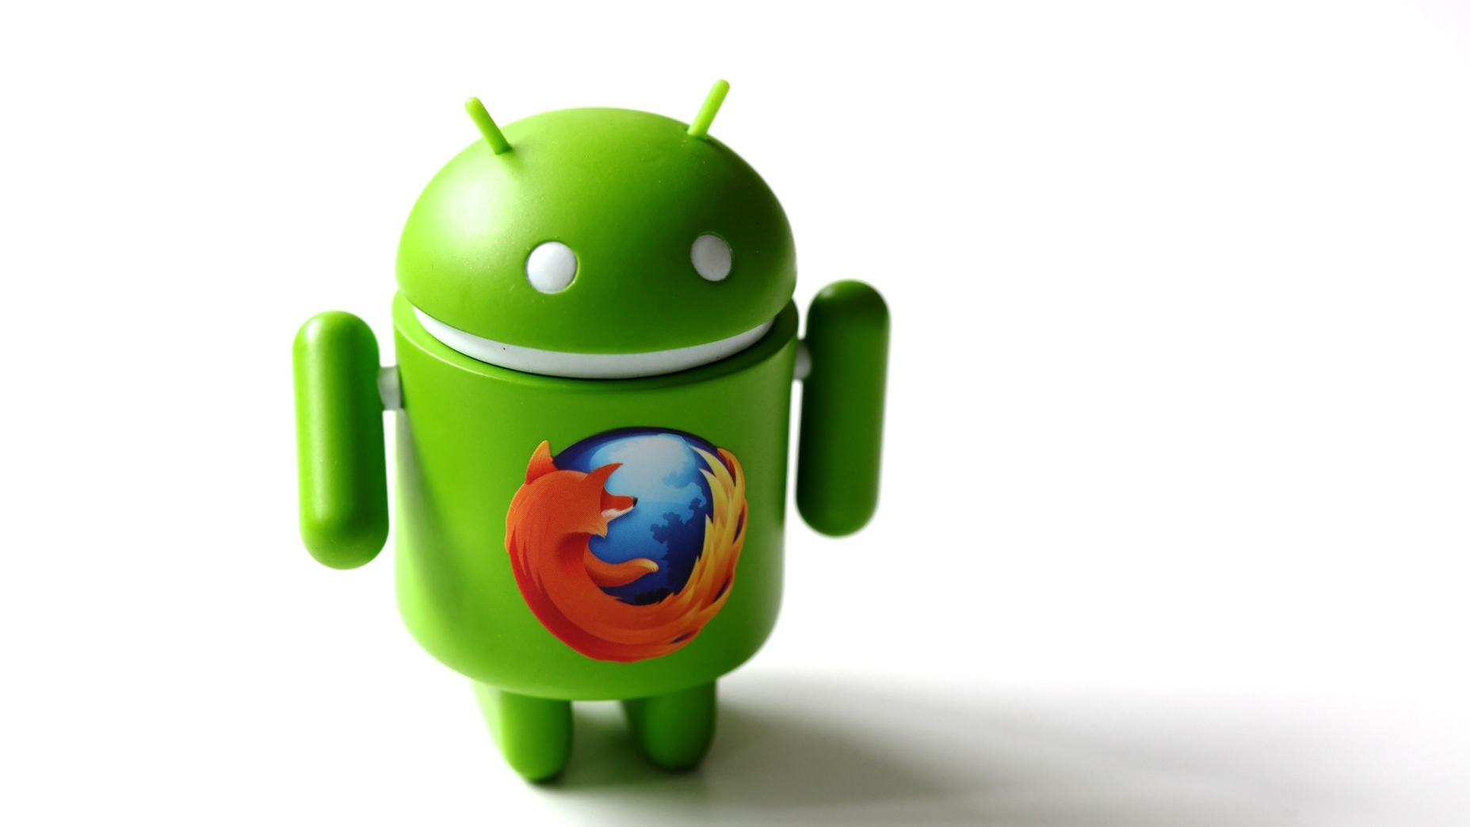
Creative Commons: http://j.mp/1iZHGAW
Notes:
What is great is that your application can be installed on an Android device using our APK Factory
If you have Firefox installed on your Android device
You can install a web application, and our APK Factory will create an Android app from it
It’s the same thing we are doing with the Desktop browser right now
So, again, you can reach more people with again, one code base

Slide 46
How to start
Notes:
So the big question is how to start

Slide 47

Creative Commons: http://j.mp/Ilm7wx
Notes:
You can just port your actual web application to Firefox OS
You saw it, i, it’s like running an unicorn
As an example, a developer I’m working with porter one of his game in 30 minutes!
Of course, it may not be your case, but we are here to help

Slide 48
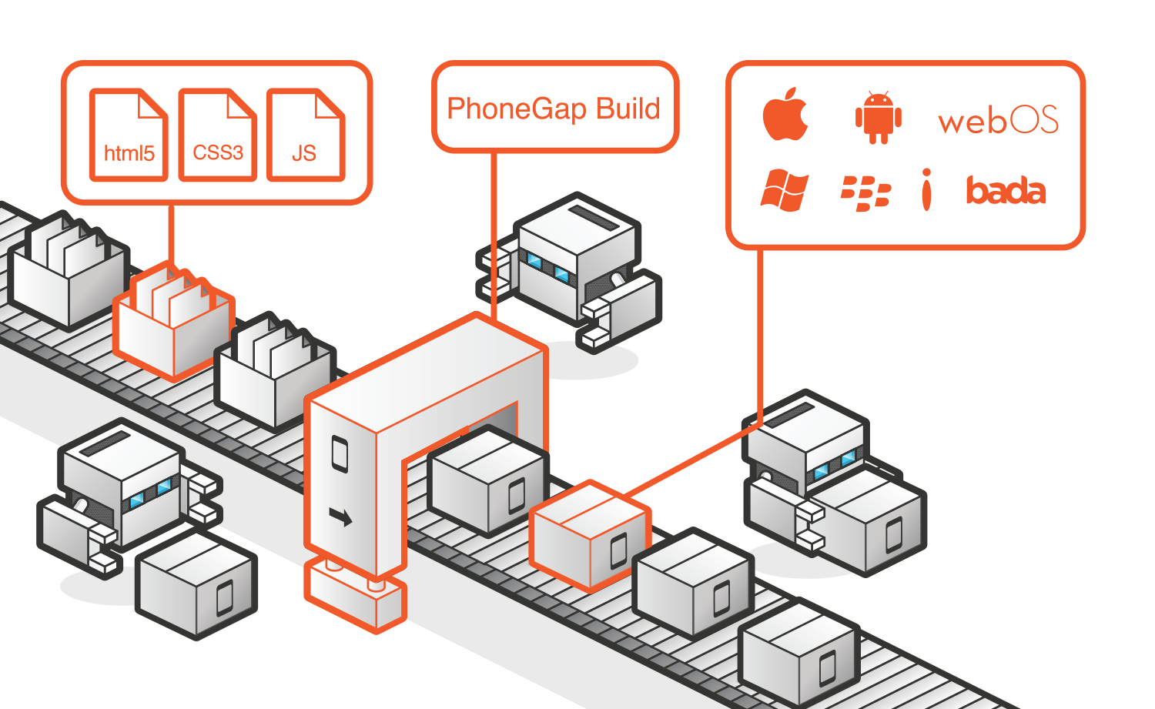

Cordova & Phonegap
Notes:
If you already use Cordova or PhoneGap
I have a good news for you, Firefox OS is now supported
It’s an easy way to build using web technology, and reach many platform

Slide 49
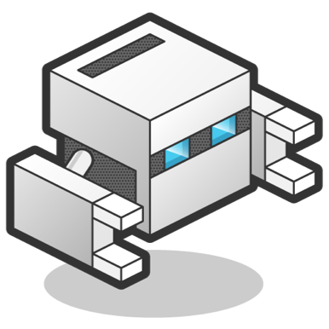
API implementations
Camera
Contacts
Device
Device-motion
Geolocation
Orientation
Vibration
Notes:
It’s quite recent, so not all API have bee implemented yet
But this is a list of those already there

Slide 50
Get ready!
$ sudo npm install -g cordova
$ cordova create hello com.example.hello HelloWorld
$ cd hello
$ cordova platform add firefoxos
$ cordova prepare firefoxos
Notes:
It’s quite easy
Even if you never use it
You need to have Node Package Manager to install Cordova
You create an application
Add your code
You add firefox os as a target platform to your project
To generate the Firefox OS app, just use the prepare argument

Slide 51
Camera API
$ cordova plugin add org.apache.cordova.camera
//Cordova code
navigator.camera.getPicture(function (src) {
var img = document.createElement('img');
img.id = 'slide';
img.src = src;
}, function () {}, {
destinationType: 1
});
Notes:
As an example, the camera API
You need to add the camera plugin to the project
When the code below will be called
It will basically call a pick web activities on the Firefox OS side
You’ll have the same experience as if you would have wrote the Firefox OS code yourself
This is the magic of PhoneGap, and Cordova

Slide 52
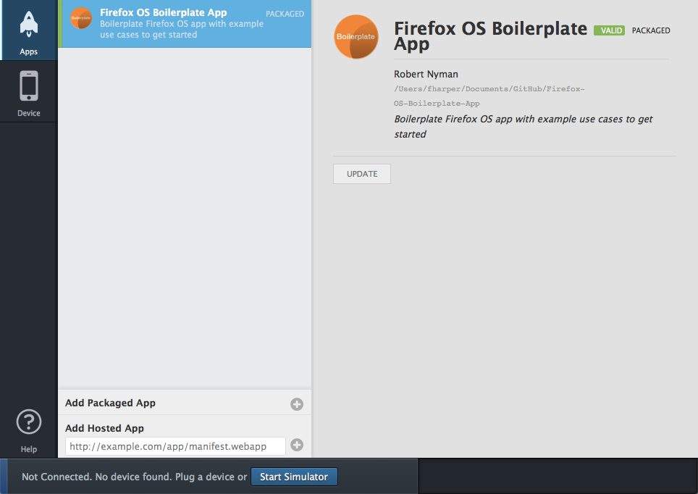
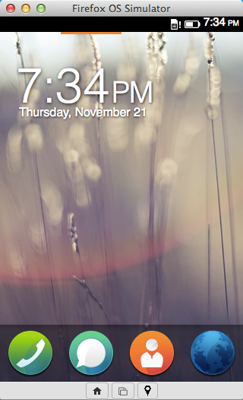
Firefox OS App Manager + Simulator (1.2+)
Notes:
As you saw with my demos
We have the App Manager, and the simulator
So no need for a real device to developer, port or test your application At least at the beginning
Because it’s HTML, CSS, and JavaScript, we don’t force you to use specific IDE
Use whatever that make sense for you

Slide 53
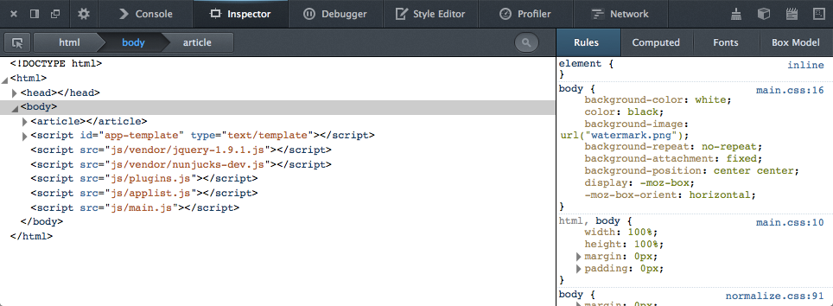
Firefox Web Developer Tools
Notes:
How many of use know Firebug?
How many of you know we have amazing developer tools directly inside the browser?
So when it comes to Firefox OS development, you can use those tools to debug on the simuatlro
But also debug on devices using Firefox OS 1.2, and plus

Slide 54
DEMO
How to debug a Firefox OS app
Notes:
Let me show you how it’s working

Slide 55
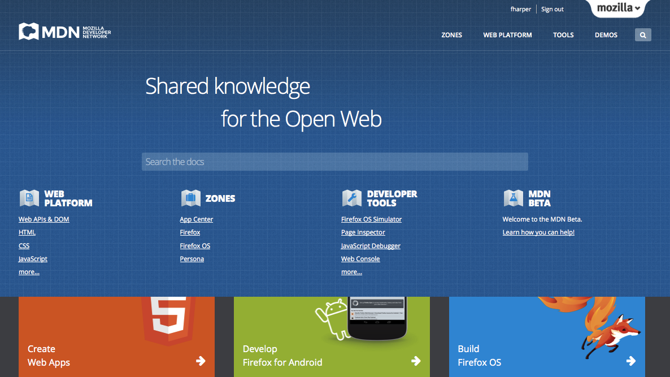
Notes:
Since you don’t have to remember everything I shown you today
And those are new APIs
We have amazing documentation online
It’s called the Mozilla Developer Network
Everything from HTML, CSS, JavaScript
To the WebAPI, and Web Activities
There also documentation about the marketplace, and how to publish your application or add the manifest file
Since it’s an open wiki, you can also help us improve the documentation

Slide 56
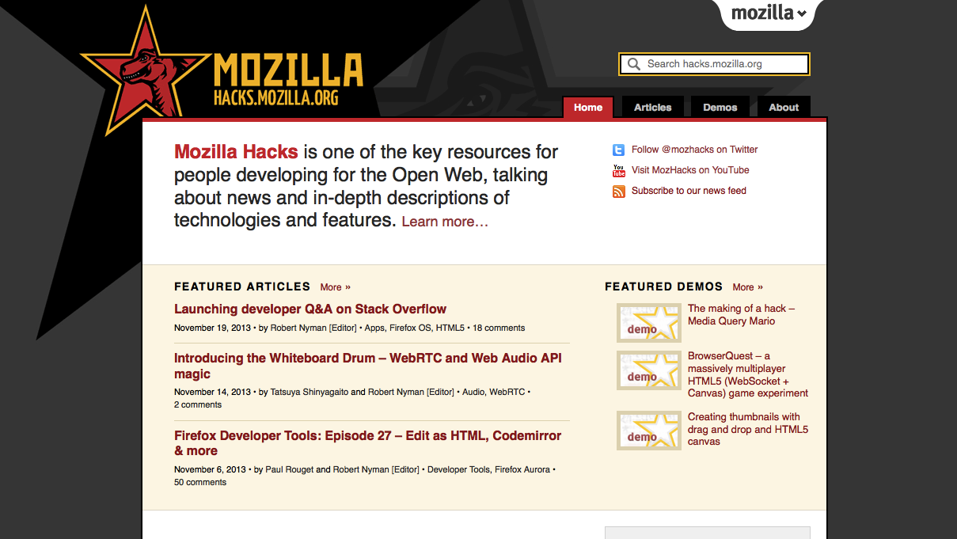
Notes:
We also have the hacks blog
It’s a blog about anything technical related to HTML, CSS, JavaScript, Firefox OS, and Firefox
I highly suggest you to hive it a look, and subscribe to the RSS feed
You can also let me know if you want to write a blog post on a technical topic web related
We are always looking for contributors

Slide 57
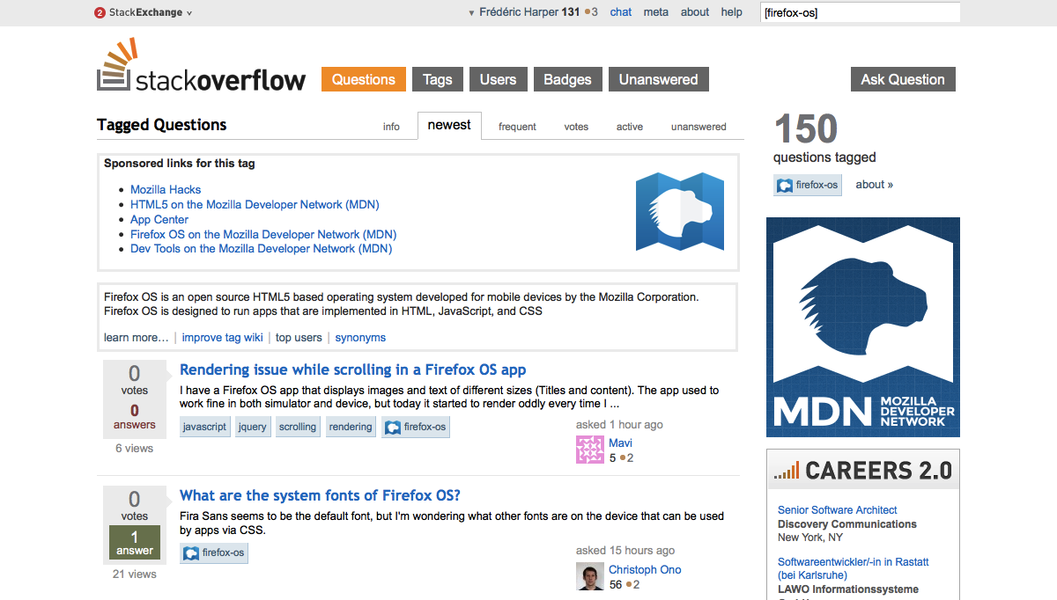
Notes:
If you need help with Firefox OS
You can always email me
But a more efficient way, would be to use StackOverflow
It’s a forum for programmers
By using it, you are building a F.A.Q. that may help other developers with the same question as you
We actively monitor the forum, but it open your questions to a huge community that may answer quicker than if you send me an email

Slide 58
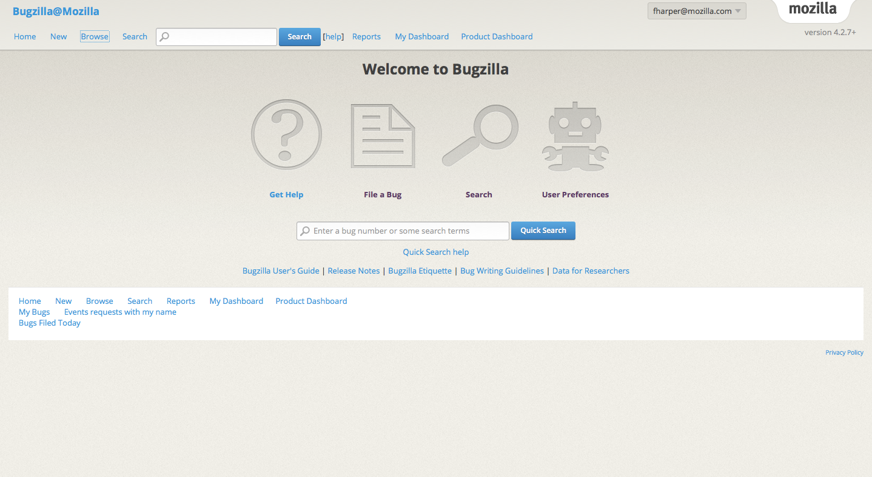
Notes:
Last, but not least, I told you Firefox OS is open
Since it’s open, you can suggest features, or report bugs by using bugzilla
This is the power of the Open

Slide 59
Some candies
Notes:
Those are the basic things you need to know to start on your Firefox OS application
But there is also some others cool stuf that can help you

Slide 60
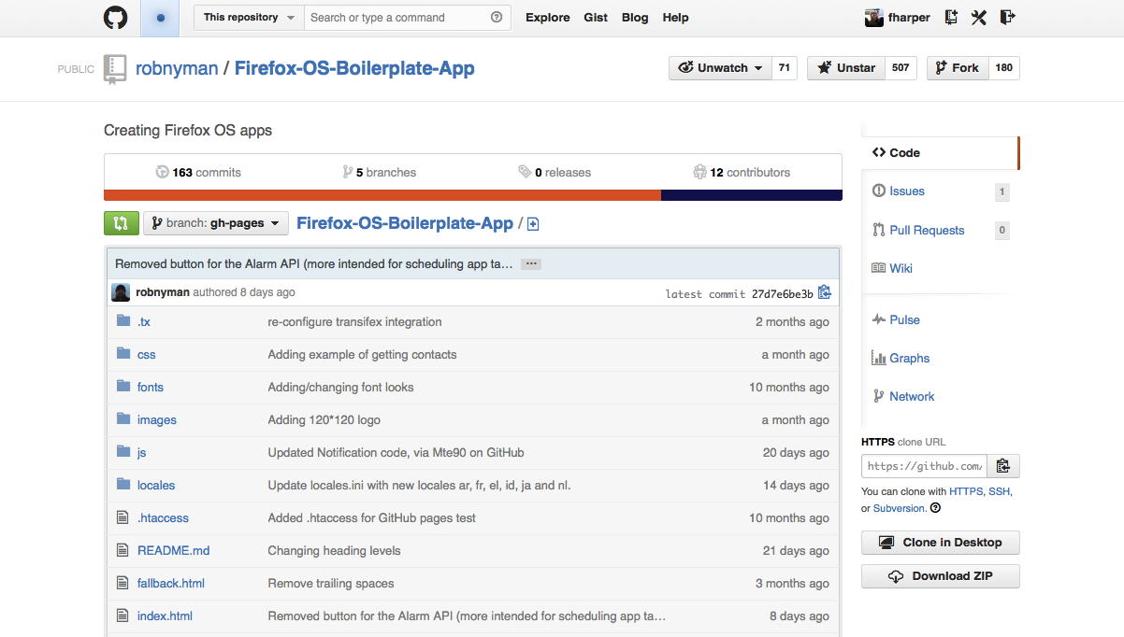
Notes:
The Firefox OS boilerplate I use for some demos
It’s a project my colleague Robert Nyman started
It’s more a demo app than a boilerplate
So it’s easy to see the code to make some of the api work, and it’s a working example
Again, since it’s on GitHub, feel free to contribute if you see any bugs or any features missing

Slide 61

Prototyping with JSFiddle
Append /webapp.manifest to install the app in the Firefox OS simulator
Append /fxos.html to get an install page like a Firefox OS hosted app.
Notes:
How many of you know JSFiddle?
It give you the ability to put your code online, modify it, and execute it live
Really nice to share code with peopleo or quickly test something
Since the developers of JSFiddle really likes Firefox OS
There are some goodies in it
If you add /webapp.manifest to the fiddle url, you’ll be able to install the app in the simulator to test it
If you add /fxos.html you be able to install your application on a real device
Really nice, again, for sharing Firefox OS code with someone, or do a quick test

Slide 62
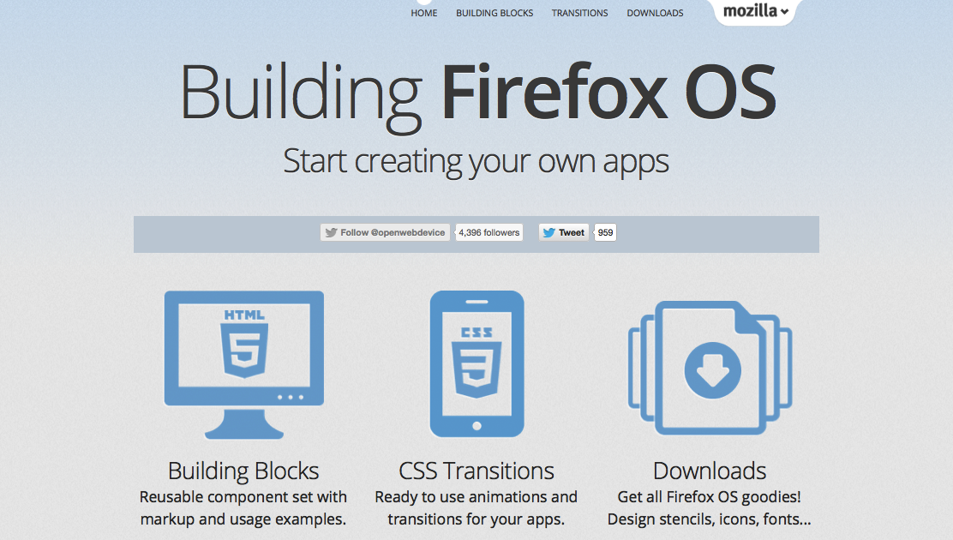
Notes:
If you are like me, you suck at UI
There is something we call Firefox OS building block
Those are prebuilt code that you can use to create easily some UI component
It will also have the same look, and feel as gaia
Keep in mind that we don’t force you to have the same UI
The goal is not having you manage many code base

Slide 63
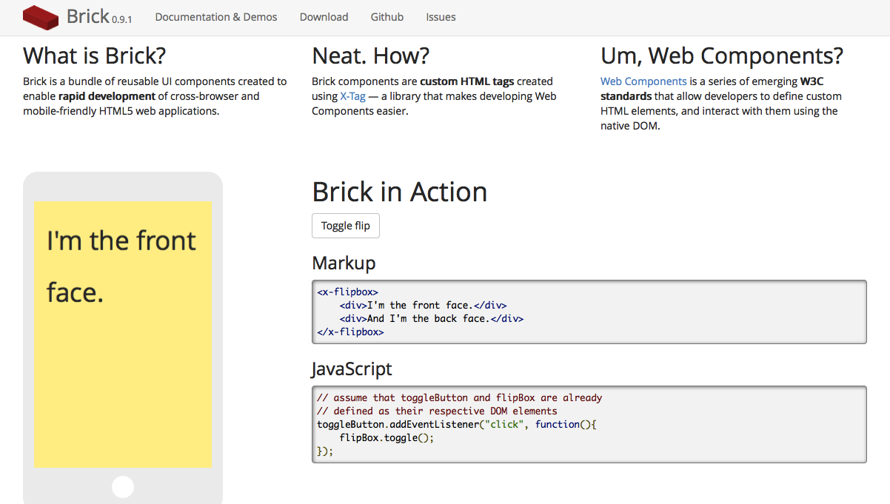
Notes:
Another candy is Mozilla Brick
It’s basically Web Components on steroid
It give you the ability to add component easily
And since it’s based on web components, it will be executed faster

Slide 64
What’s next
Notes:
So what’s is next for Firefox OS

Slide 65
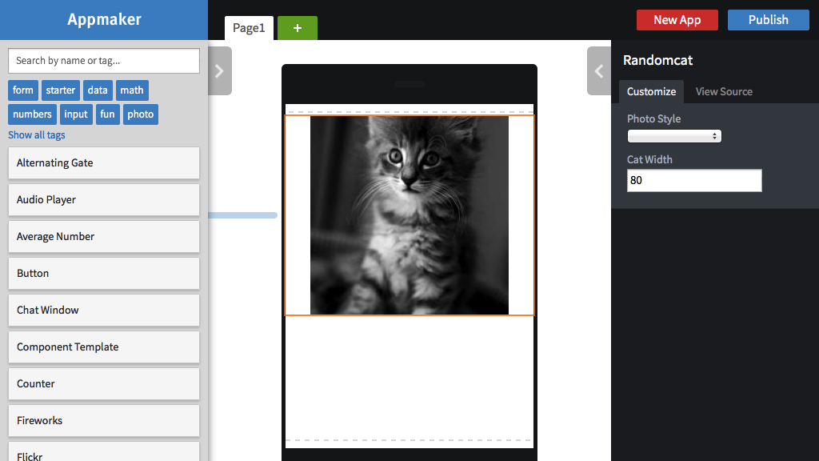
Notes:
We are working on something call Mozilla App Builder
You can already use it, the URL is in my resources slide at the end of my presentation
It’s an app builder, with some drag, and drop components to make it easier to create application
Since with the web, everybody can be a creator, let’s make this happens

Slide 66
More Web APIs & features
Calendar API
FileHandle API Sync API
Keyboard/IME API WebRTC
HTTP-cache API
Peer to Peer API
Spellcheck API LogAPI
Resource lock API
UDP Datagram Socket API
WebNFC
WebUSB
Notes:
Of course it’s only the beginning
We are always improving the OS
Some new APIs will be added like WebNFC or WebUSB

Slide 67

To infinity, and beyond…
Creative Commons: http://j.mp/1gIdcPF
Notes:
So keep in mind, it’s only the beginning
There is a lot more things coming
Firefox OS already have a lot of traction
It’s a new audience you may not be able to reach before

Slide 68
When you’ll build your next app
Why not think about the web first…
Notes:
So next time you have to build a mobile application
Why not start with the web
More reach, more visibility, and easier to do

Slide 69
Resources
Firefox OS Simulator
http://j.mp/fxosSimulator
Firefox OS App Manager
http://j.mp/fxosAppManager
Mozilla Developer Network
https://developer.mozilla.org
StackOverflow forum
http://j.mp/fxosStackOverflow
Firefox OS Boilerplate
http://j.mp/fxosBoilerplate
Firefox OS UI Component
http://buildingfirefoxos.com/
Mozilla Brick
http://j.mp/mozBrick
Mozilla Appmaker
https://appmaker.mozillalabs.com/
Notes:
Some resources
Again, don’t take notes
You’ll only have one URL to remember, and I’ll tell you at the end of the presentation
As I’ll upload my slides, and a recording of my presentation online

Slide 70
Join us for an epic workshop
http://mozhacks.wufoo.com/forms/firefox-os-app-workshop-prague
Notes:
Before I finish
We’ll do a workshop in Prague, probably in June
The date isn’t confirmed yet, but you can register right now
It’s an invite only event, so it’s not because you register that you will be invited
It’s a day where myself, and my colleage Jason, will do two small presentation to give you the tools you need to start your application
And the rest of the day will be about porting actual HTML application you have, and build new one
Since we’ll be on site, you’ll have the help you need
Last, but not least, we’ll finish the day with a dinner, and some drinks
I can’t wait to be back here, and see all the amazing app you’ll build during this workshop
So please subscribe, even if you aren’t sure to come

Slide 71
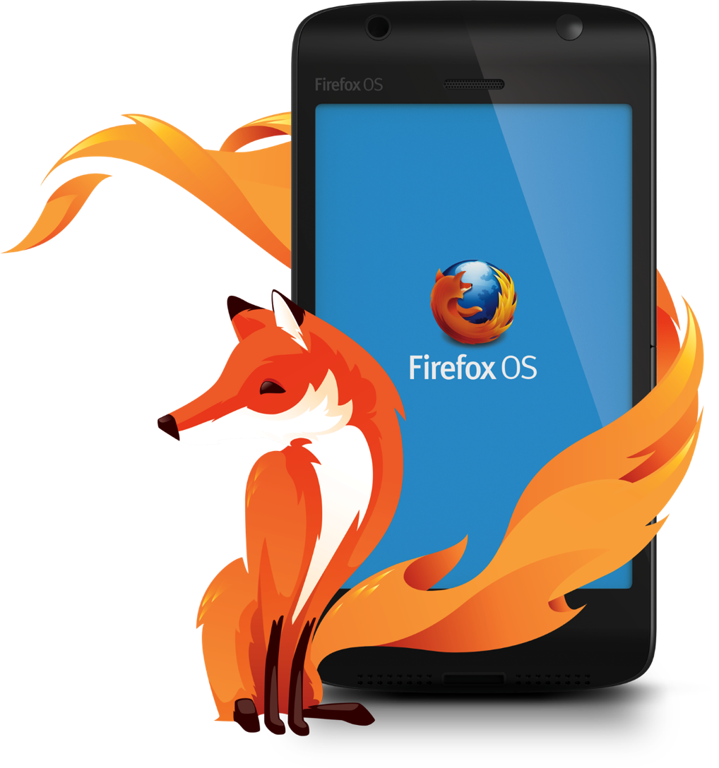
Planning to port
or build a
Firefox OS app?
Please let me know!
Notes:
If you can’t wait for the workshop
And you are currently or planning to build a Firefox OS application, please let me know
I’ll also be curios to see any other HTML5 application you actually have
There are good opportunities with the platform, and I would like to help you to publish your application to the marketplace

Slide 72

Frédéric Harper
fharper@mozilla.com
@fharper
http://hacks.mozilla.com
http://outofcomfortzone.net
Notes:
Feel free to follow me on Twitter or add me to LinkedIn
If you want to read some amazing technical posts, again, don’t forget the hacks blog
Last, but not least, you can check my personal blog: it’s all about gnomes, and unicorns
It’s also where, probably tomorrow, I’ll publish my slides as the recording of my presentation
So it’s the only link to remember
Thanks a lot, any questions, comments, insults?

